Slide 1
Supply Chain
File created on: 2/19/2021 12:29:45 PM

Slide 2
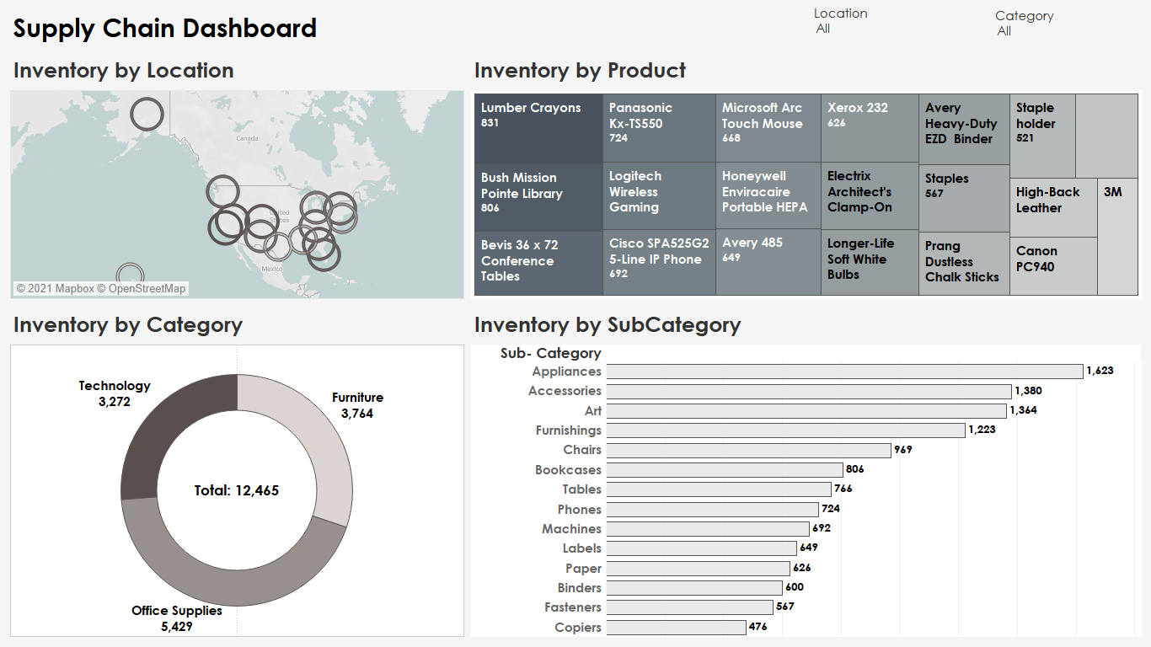

Slide 3
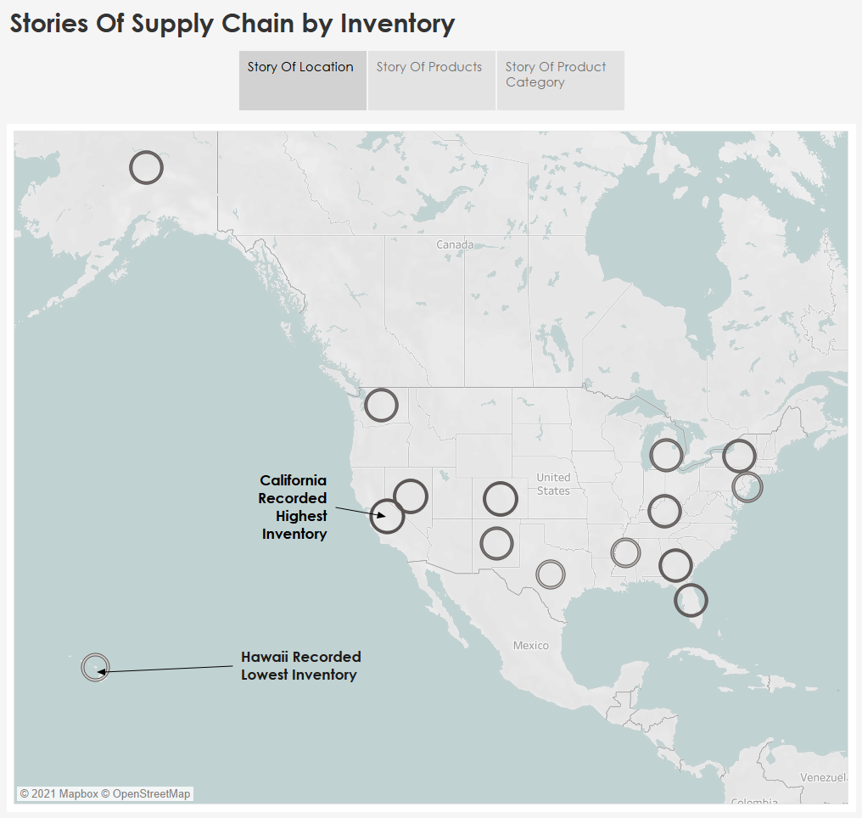

Slide 4
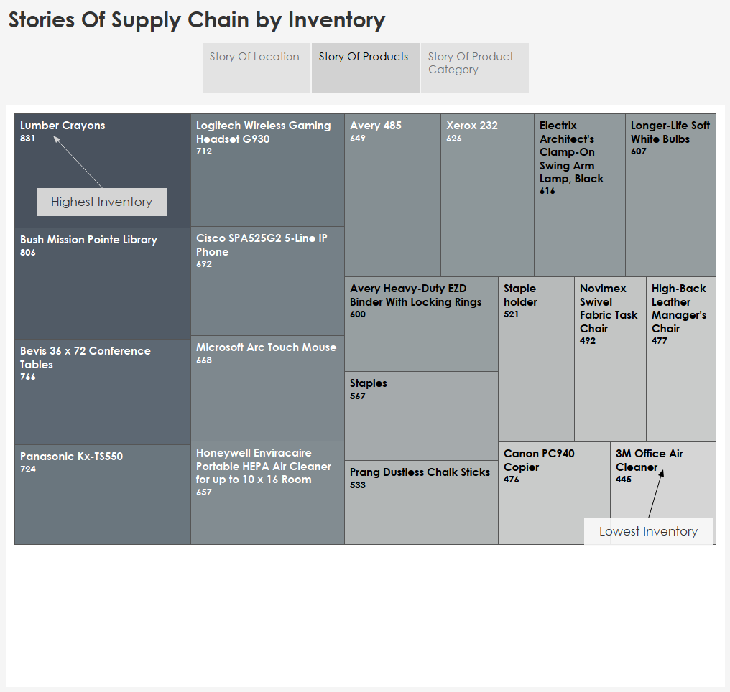

Slide 5
